Slide 1
Interpolation of Simple Harmonic oscillators
By: Richard Guaman

Slide 2
Goal
Observing real life phenomena accurately (to the nanoseconds/nanometer of precision) is difficult to do without instruments that are costly.
The purpose of this experiment is to explore the viability of using an instrument that is perhaps not as accurate, but uses interpolation methods to, essentially, “fill in the gaps” between data points.

Slide 3
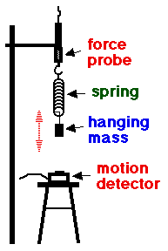
Background knowledge/experiment
Simple harmonic motion is a type of movement where an object is constant distance from a central point/equilibrium position (springs are a perfect example).
A lab experiment was conducted where a spring was attached to an apparatus with a weight on the other end of the spring. A motion detector captured the movement of the mass along with velocity and acceleration.

Slide 4
Interpolation Methods
Using the data from a lab with a very expensive motion detector as a reference, the following interpolation methods were investigated:
Lagrange Interpolating Polynomial
Piece-wise Linear Interpolation
Newton’s Divided Difference Method
Neville’s Method of Polynomial Interpolation

Slide 5
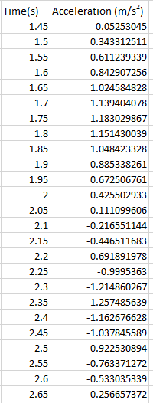
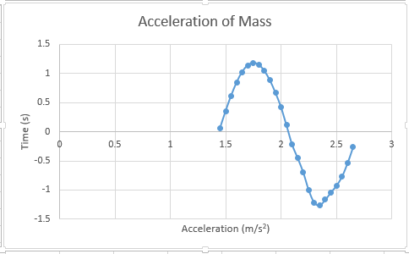
Lab data
**For testing purposes, the time/acceleration values were taken from 1.45 up to 2.65 in increments of .1 and inserted into the code for each interpolation method.**

Slide 6
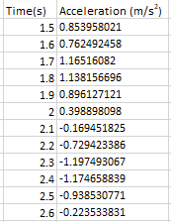
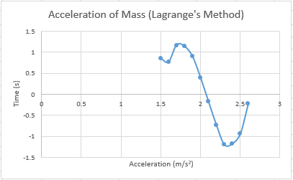
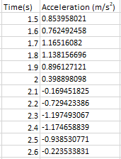
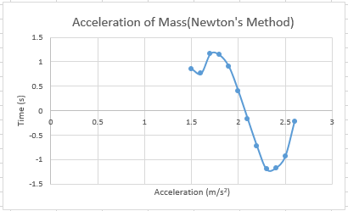
Interpolation Results (1)

Slide 7
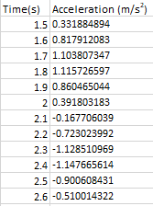
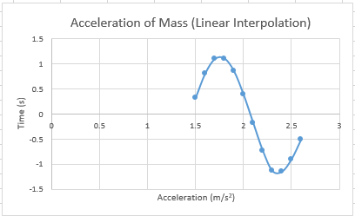
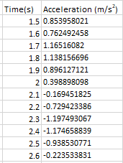
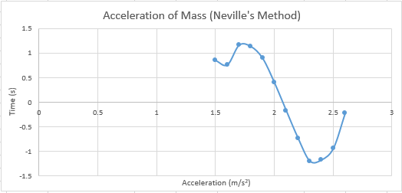
Interpolation results (2)

Slide 8
Further Investigation
Errors for each method must be calculated in order to determine how accurate a given method is compared to the others.
Perhaps test the methods against other data such as the position or velocity of the mass.
Investigate the importance of the error term in regards to each method.
Explore other methods of interpolation (Stirling’s, Cubic spline, etc.).

